Slide 1
Priority Replenishment Review
May 17, 2018
Priority Replenishment Inventory
Dispatch Environment
UAT Functions
Release 1
Date: May 17- 25

Slide 2
Priority Replenishment Review
May 17, 2018
Test Link
Use the following link to the application:
http://w7-2ua50628kw.wdw.disney.com:8626/pride/

Slide 3
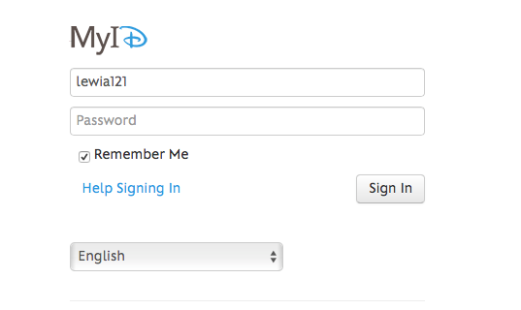
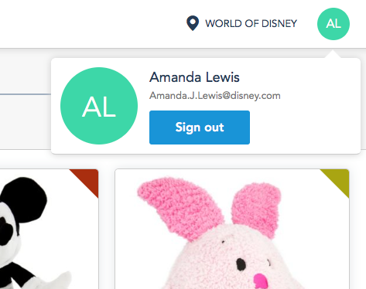

Priority Replenishment Review
May 17, 2018
Logging In and Out
Logging In
Logging Out
The Cast Member will be directed to MyID to log in.
Sign out in the top right corner by selected your MyID log in initials.

Slide 4
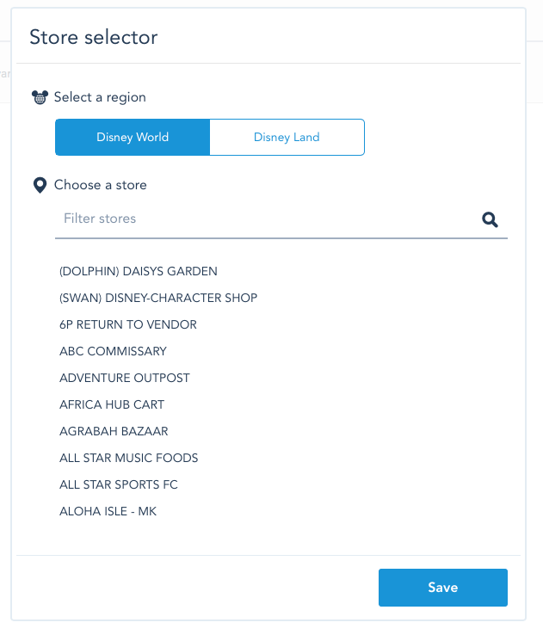
Priority Replenishment Review
May 17, 2018
Select Region and Store
Select the region and store, then click Save.
Note: The most robust stores are Emporium, Mouse Gear and World of Disney.

Slide 5
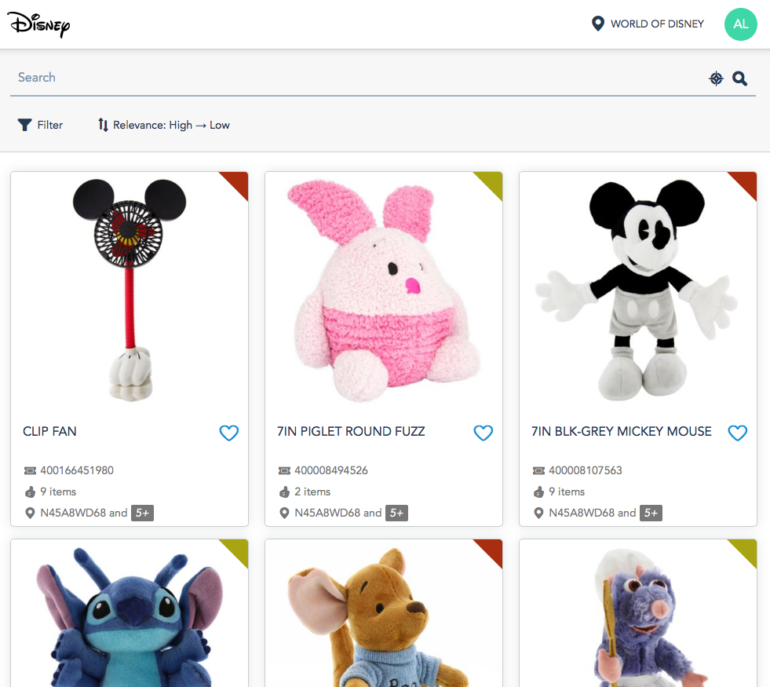
Priority Replenishment Review
May 17, 2018
Select Region and Store
View Items to Pick
Unassigned items or items assigned to you will show in the list.
Items assigned to someone else will not show on this list

Slide 6
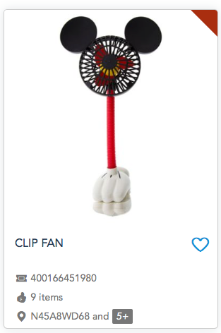
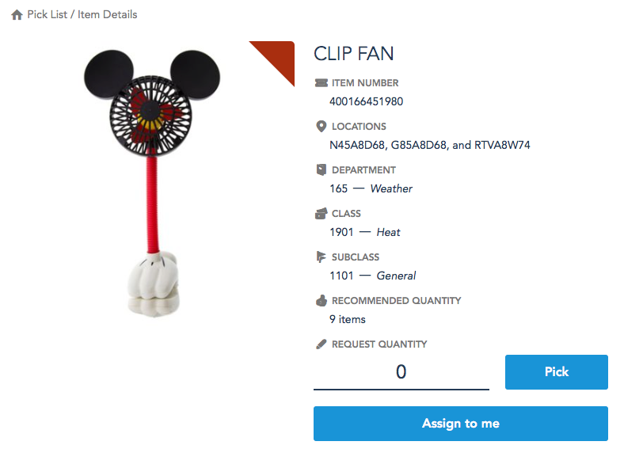
Priority Replenishment Review
May 17, 2018
Select Region and Store
View Items to Pick
Select in List
View Item Detail
Select the item in the list to view the detail.
The detail screen will open.

Slide 7
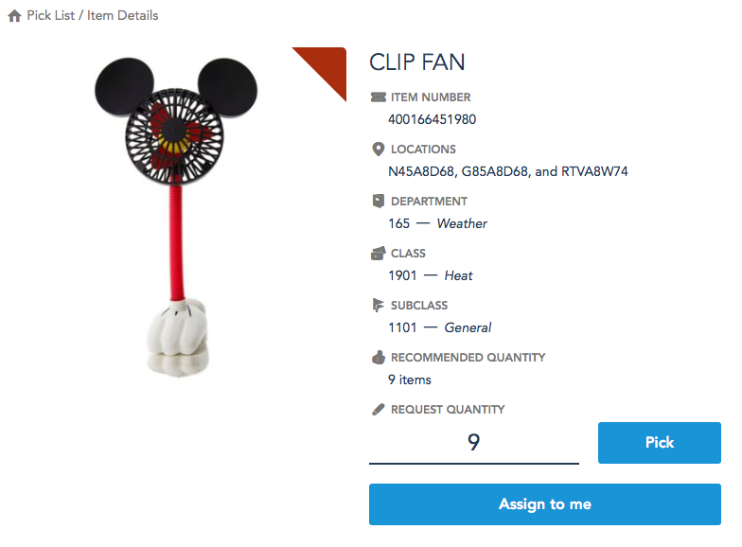
Priority Replenishment Review
May 17, 2018
Select Region and Store
Pick Item
Enter the quantity picked and click “Pick.”

Slide 8
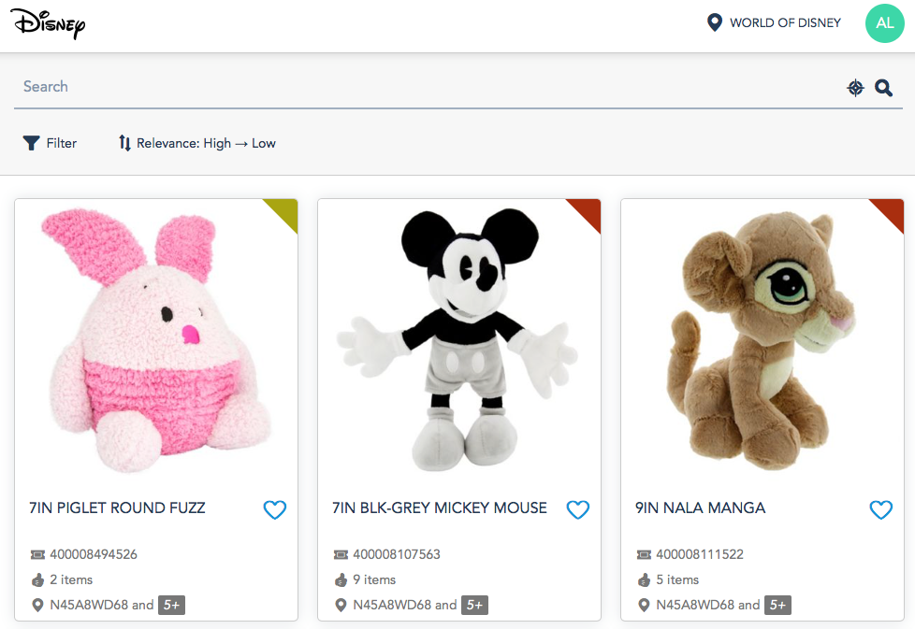
Priority Replenishment Review
May 17, 2018
Select Region and Store
Picked Item - Removed from the list
(No more Clip Fan in the list!)
After the item is picked, it will be removed from the list view until it reaches the PQ % or minimum sales quantity configured in the application.

Slide 9
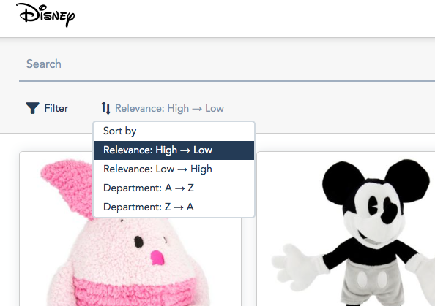
Priority Replenishment Review
May 17, 2018
Select Region and Store
Sorting the Picklist
Sorting Rules
Relevance (Red or Yellow flag) based on the PQ % or minimum sales quantity configured.
Relevance will sort in the following order: relevance, department, class, subclass, item.
Department will sort department, class, subclass, item

Slide 10
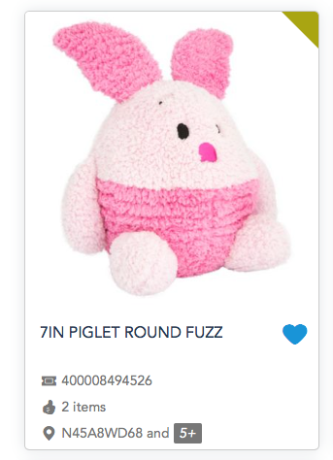
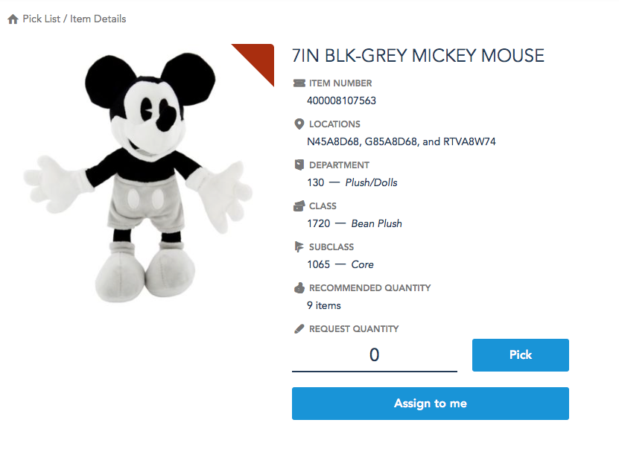
Priority Replenishment Review
May 17, 2018
Select Region and Store
Assigning Self to Pick
Assigning in List
Assigning in List
Assign self to an item in the list by
selecting the heart.
Assign self to an item in the item details page by selecting “Assign to Me.”

Slide 11
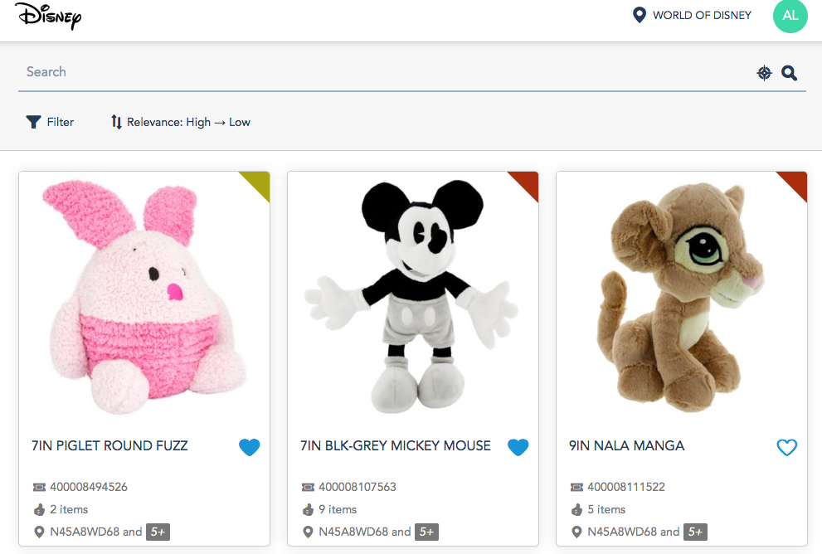
Priority Replenishment Review
May 17, 2018
Select Region and Store
Assigned Items in List
Items assigned to you show with a filled heart.
Items assigned to others will not show on your list
Assigned
Assigned
Not Assigned

Slide 12
Priority Replenishment Review
May 17, 2018
Select Region and Store
Notes
This is a pre POC release and will not have guaranteed availability.
It will generally be available all day with the hours of 6-8 am EST being the focus for availability.
Disneyland availability will be determined soon.

